Slide 1
Machine Learning !
Goal of “Machine Learning” is to build computer systems that can learn from their experience and adopt to their environments.
Machine Learning is an important aspect or component of Intelligence.
Intelligence is ability to Learn.

Slide 2
Well-posed Learning Problems
Jacques Hadamard (1865-1963) was a leading light of French mathematics.
He defined the term “well-posed problem”:
a problem that has a unique solution that changes continuously with the initial conditions.

Slide 3
Ill-posed problems
Ill-posed problems are typically the subject of machine learning methods and artificial intelligence, including statistical learning. These methods do not aim to find the perfect solution; rather, they aim to find the best possible solution and/or the solution with the least errors.

Slide 4
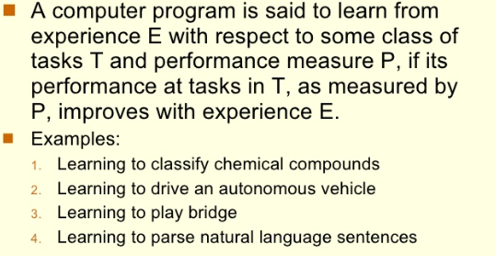
Machine Learning

Slide 5
Intelligence
Intelligence
Ability to solve problems
Examples of Intelligent Behaviors or Tasks
Classification of texts based on content
Heart disease diagnosis
Chess playing

Slide 6
Concept Learning
Inferring a Boolean-valued function from training examples of its input and output.

Slide 7
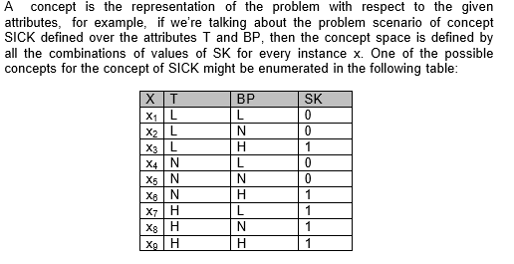
Concept Space

Slide 8
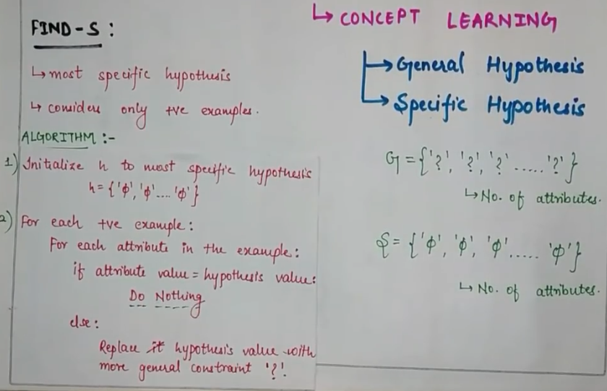
Find S Algorithm

Slide 9
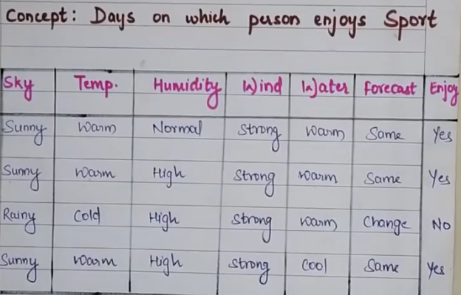
Data Base

Slide 10
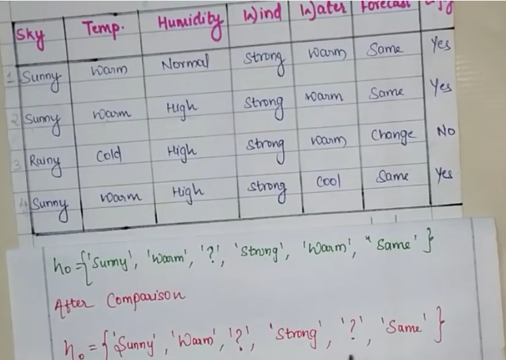

Slide 11
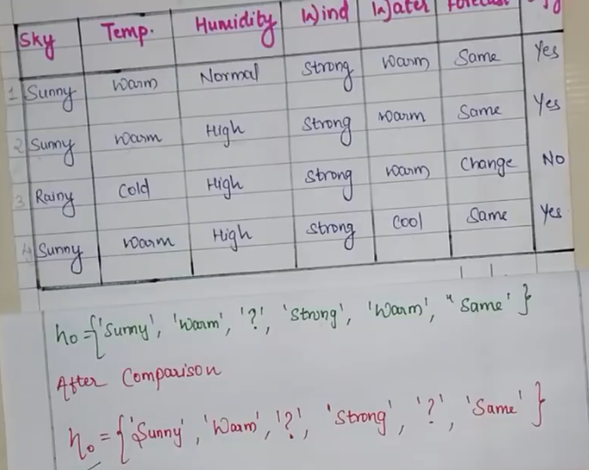

Slide 12
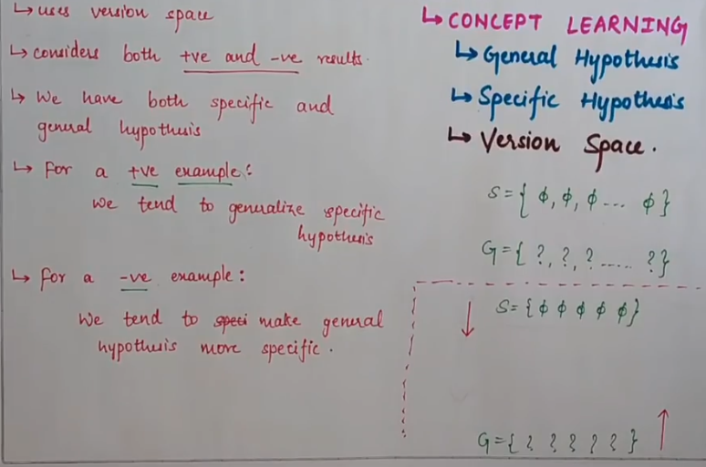
Candidate Elimination Algorithm

Slide 13
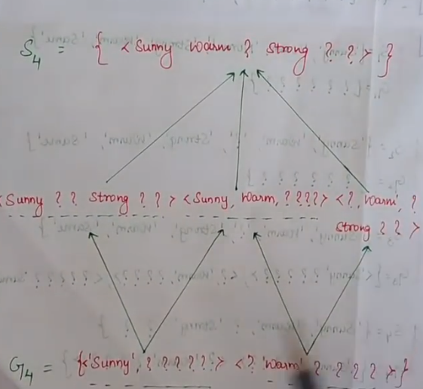
Version Space

Slide 14
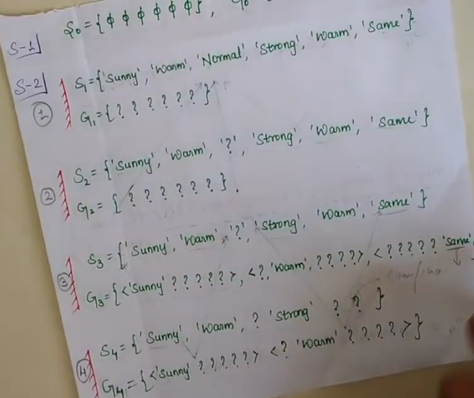
Solution

Slide 15
Feature Extraction and Selection
Feature Extraction aims to reduce the number of features in a dataset by creating new features from the existing ones (and then discarding the original features). These new reduced set of features should then be able to summarize most of the information contained in the original set of feature. In machine learning, pattern recognition and in image processing, feature extraction starts from an initial set of measured data and builds derived values (features) intended to be informative and non-redundant, facilitating the subsequent learning and generalization steps, and in some cases leading to better human

Slide 16
Why feature extraction?
The process of feature extraction is useful when you need to reduce the number of resources needed for processing without losing important or relevant information. Feature extraction can also reduce the amount of redundant data for a given analysis.

Slide 17
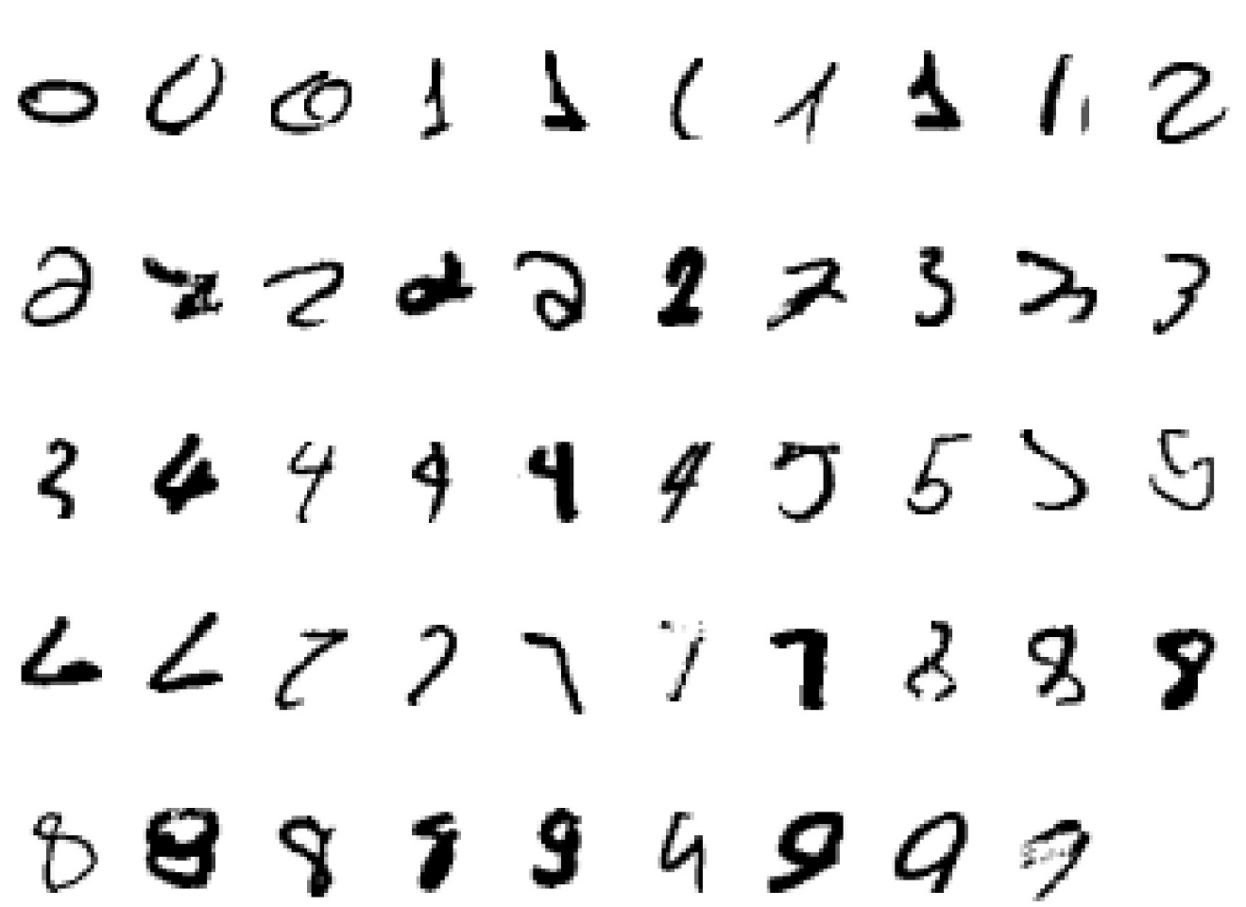
A classic example of a task that requires machine learning: It is very hard to say what makes a 2

Slide 18
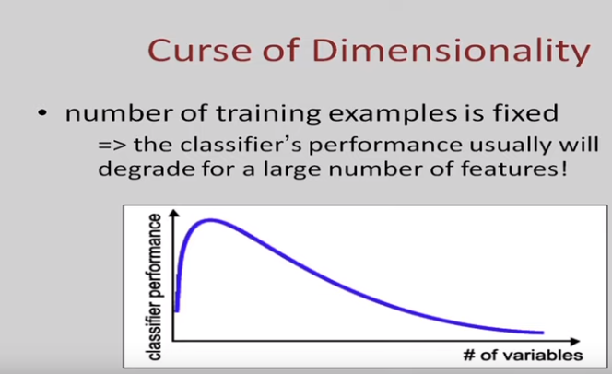
Curse of Dimensionality

Slide 19
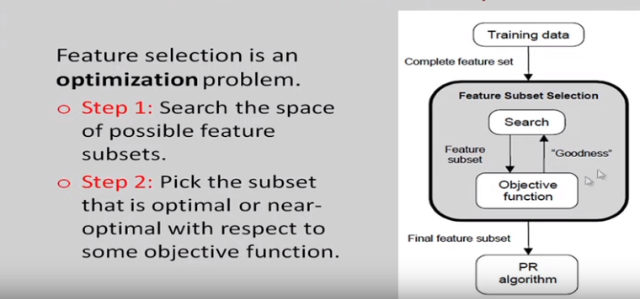
Steps of Feature Selection

Slide 20
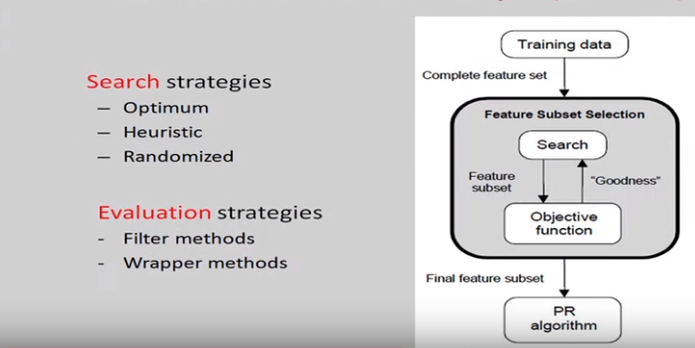
Steps continued

Slide 21
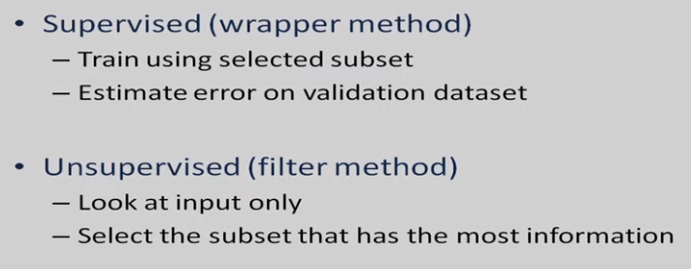
Evaluation of Subsets

Slide 22
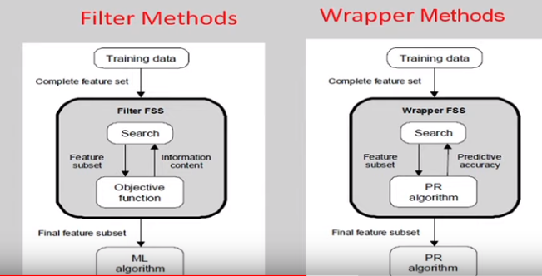
Evaluation Strategies

Slide 23
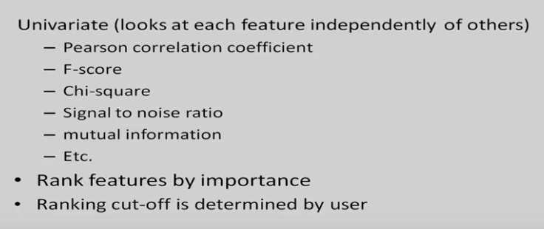
Feature Selection

Slide 24
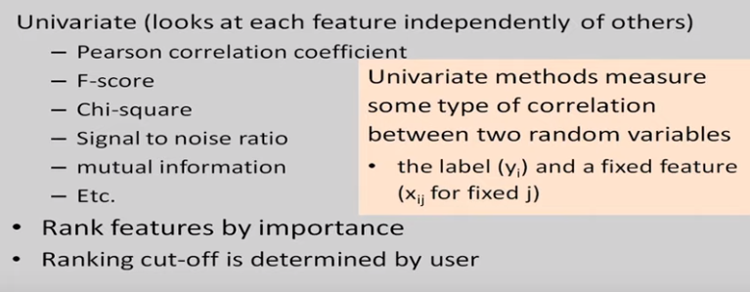
Feature Selection

Slide 25
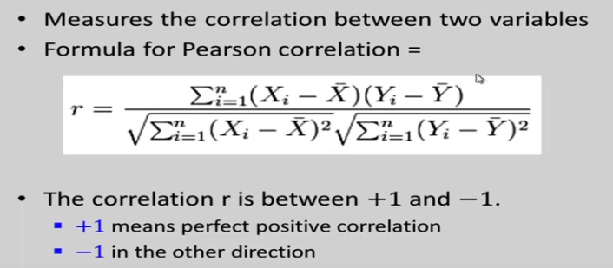
Pearson Correlation Coefficient

Slide 26
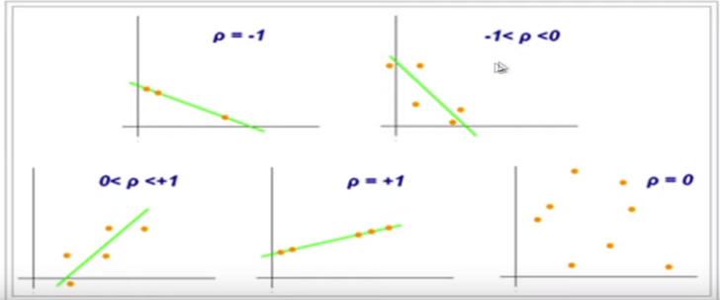
Result

Slide 27
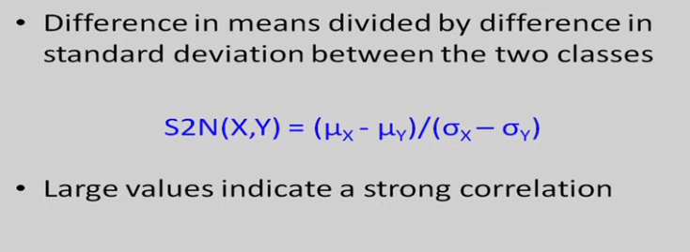
Signal to noise ratio

Slide 28
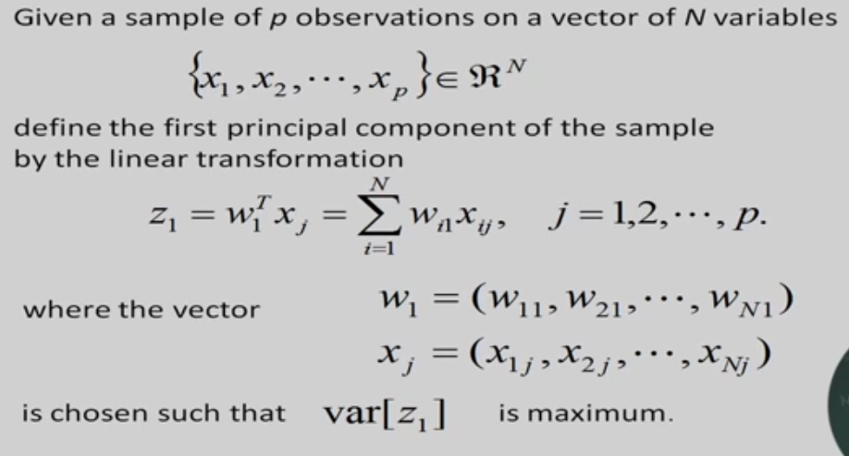
Algebraic Definition of PCs

Slide 29
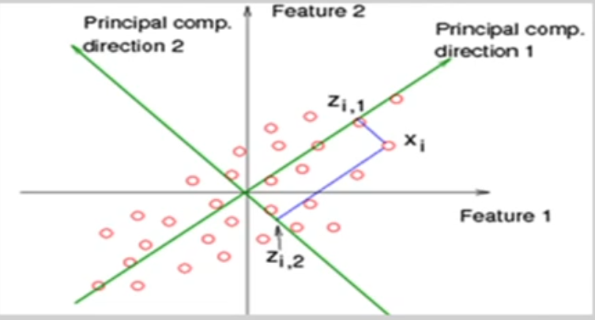

Slide 30
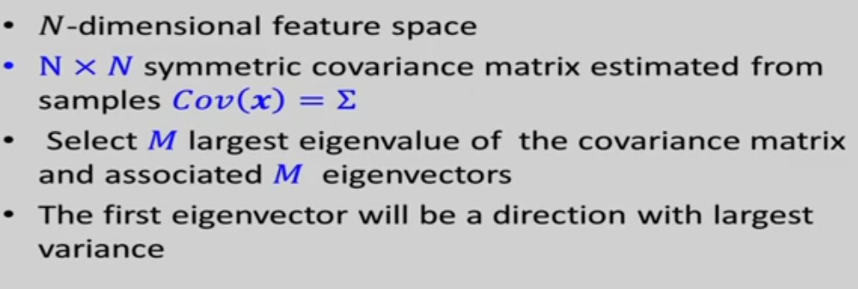
PCA

Slide 31
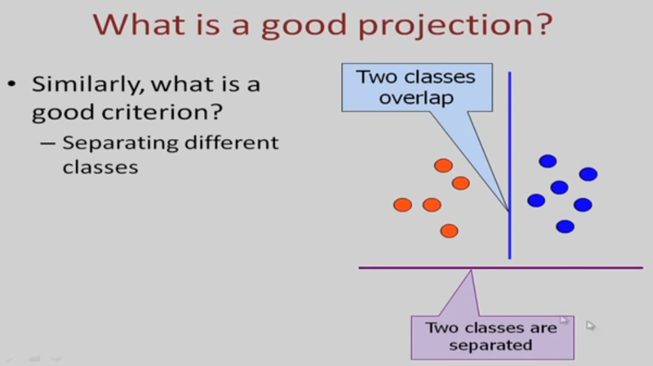

Slide 32
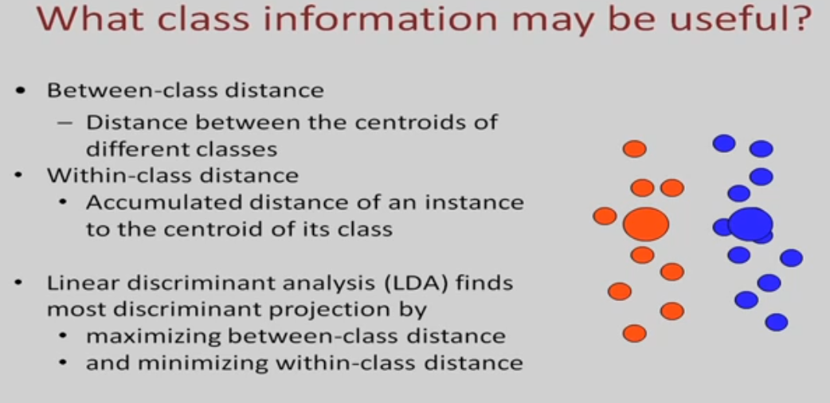

Slide 33
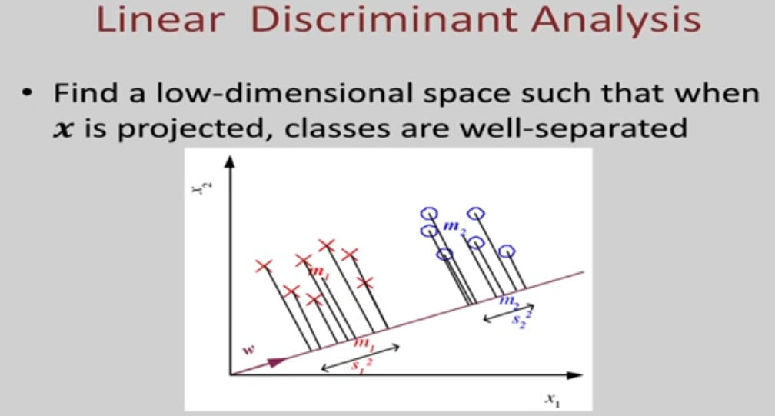

Slide 34
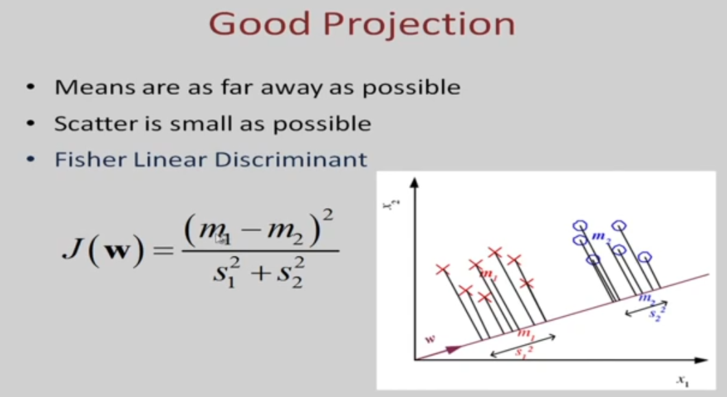

Slide 35
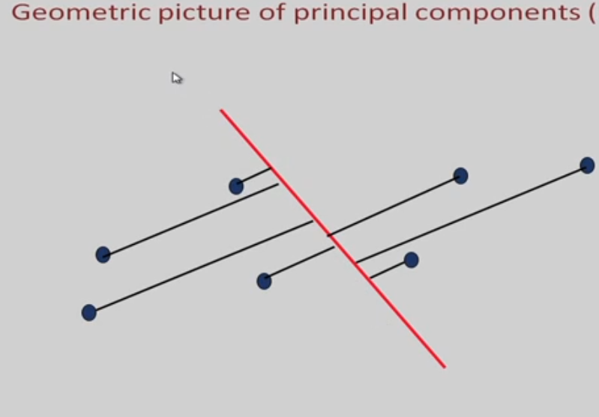

Slide 36
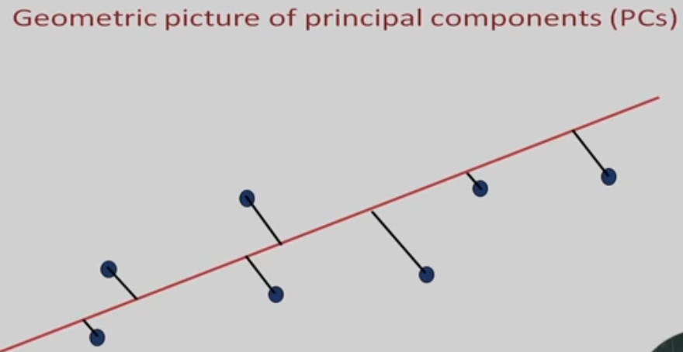

Slide 38
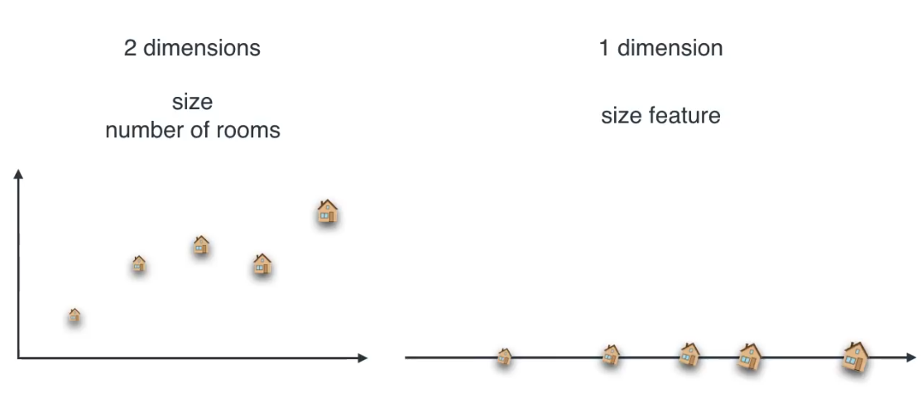

Slide 39
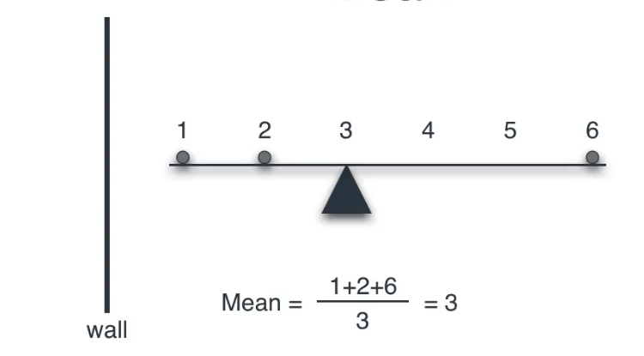
Mean

Slide 40
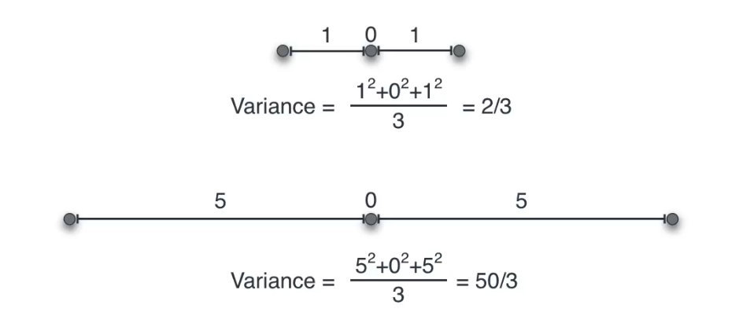
Variance

Slide 41
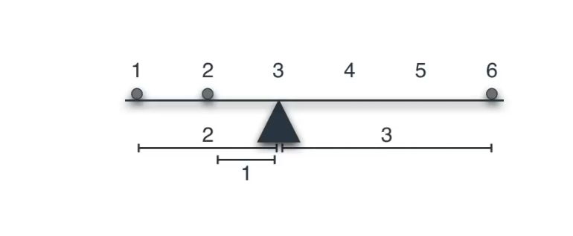
Mean and Varience

Slide 42
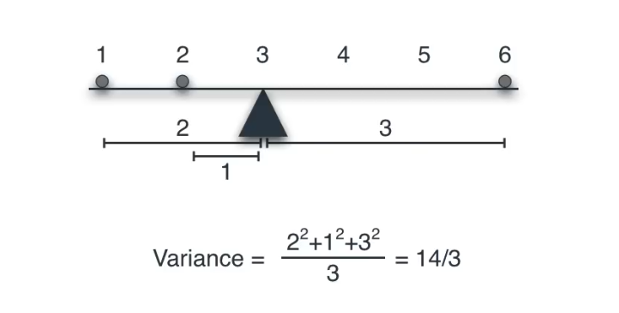
Varience

Slide 43
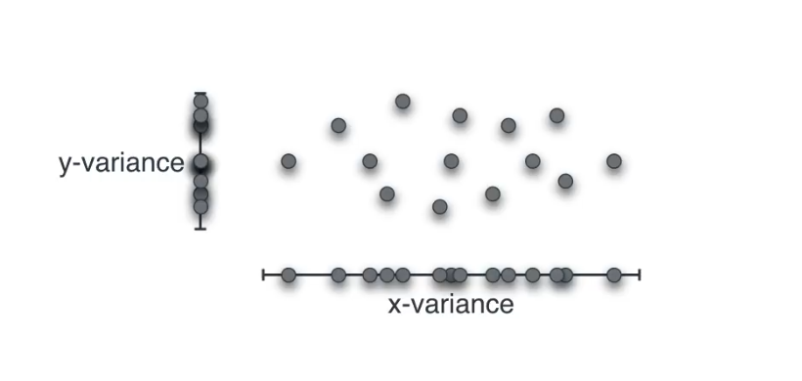

Slide 44
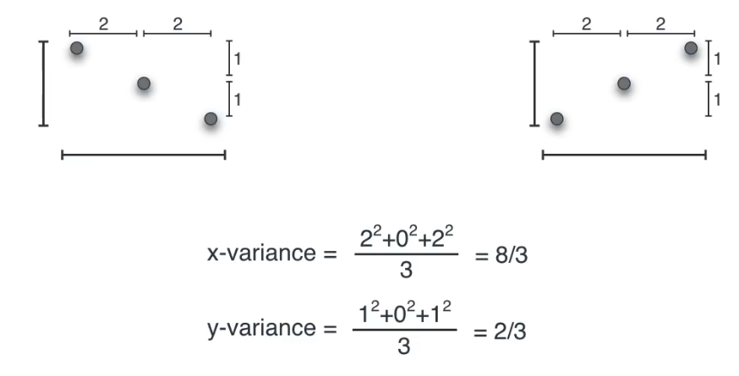

Slide 45
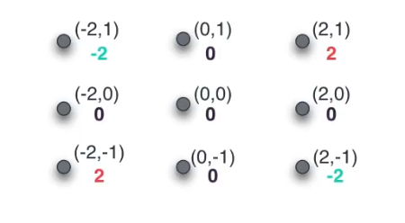
Covarience

Slide 46
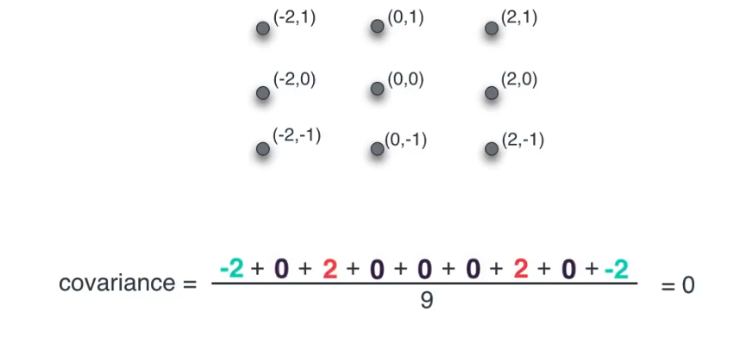

Slide 47
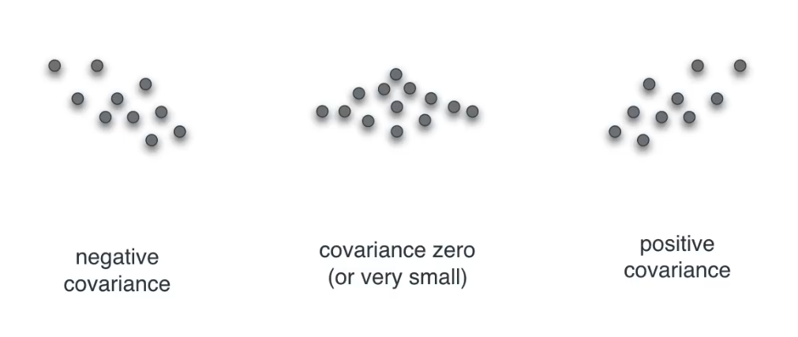

Slide 48
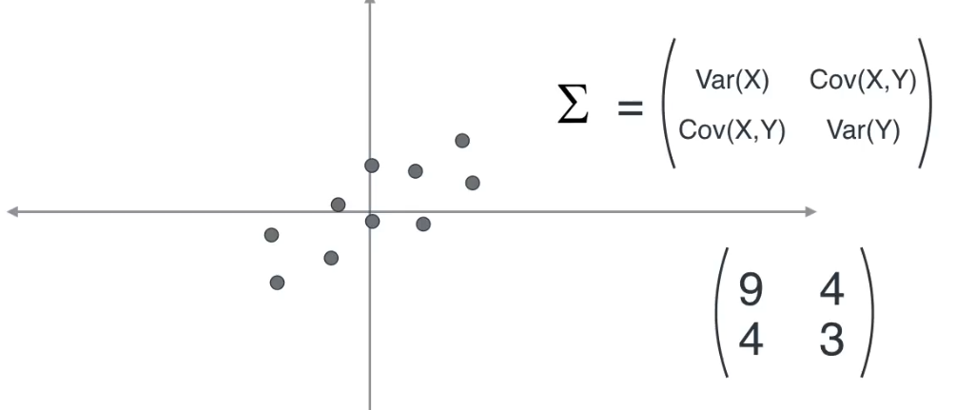
Covariance Matrix

Slide 49
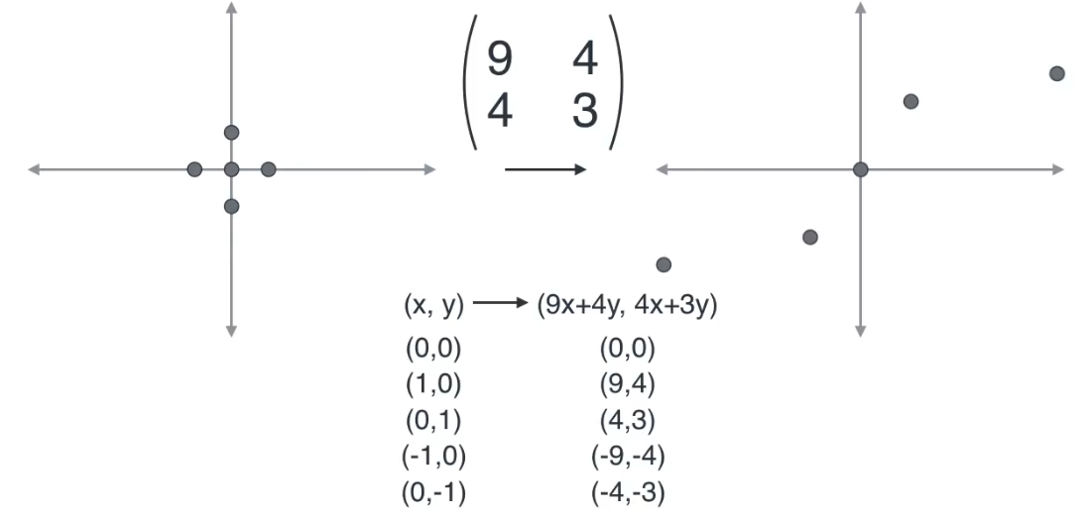
Linear Transformation

Slide 50
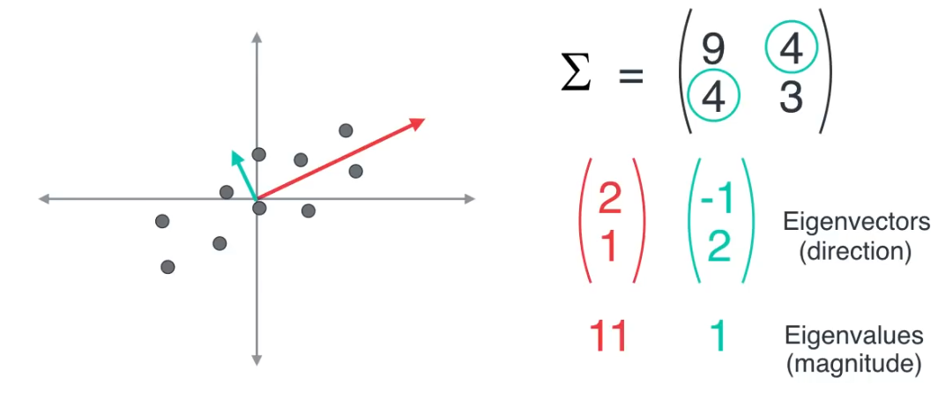

Slide 51
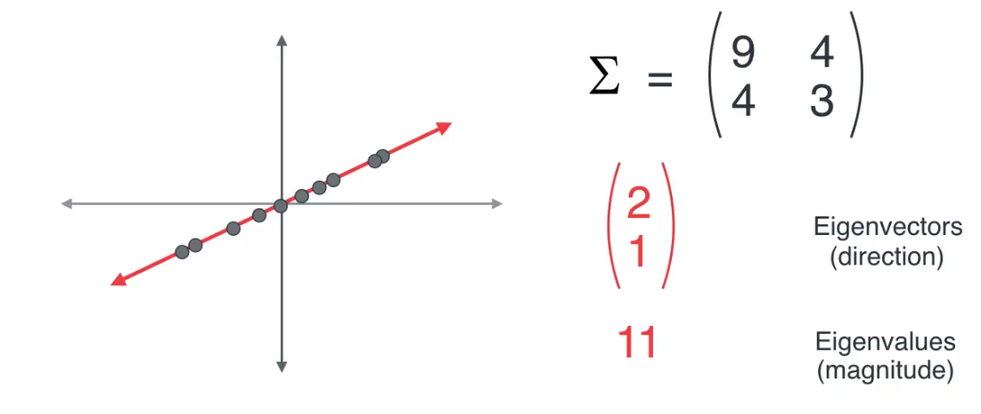

Slide 52
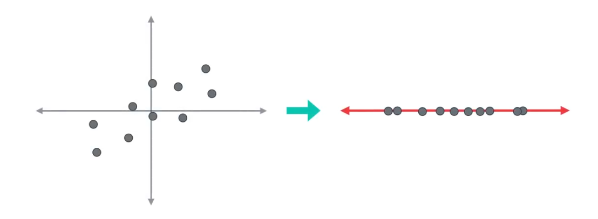

Slide 53
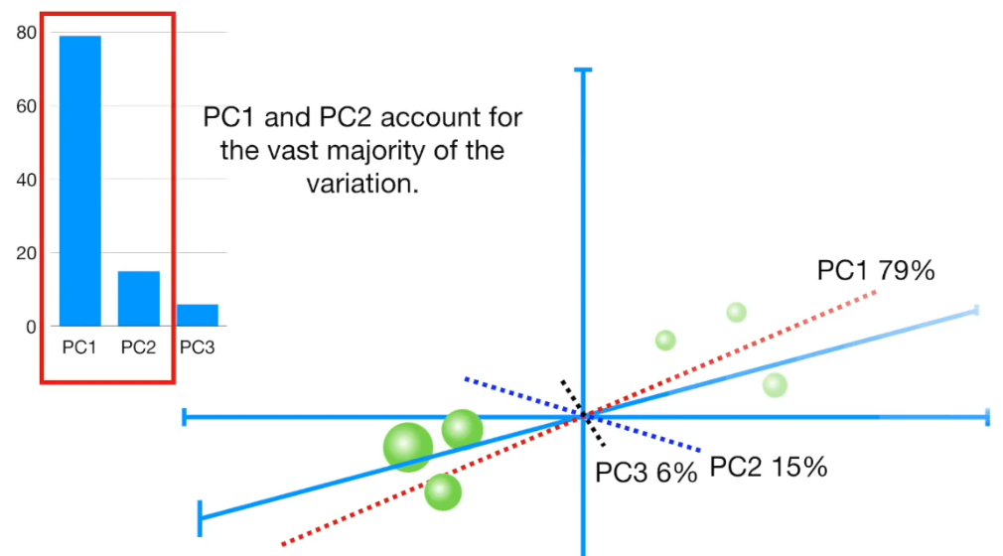

Slide 54
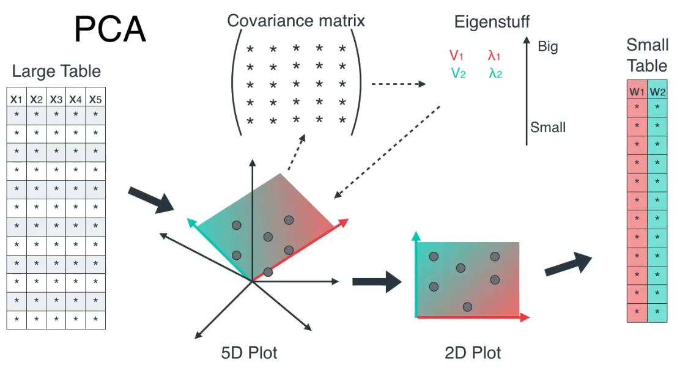

Slide 55
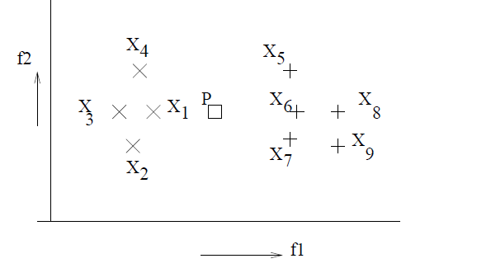
Dataset of two classes

Slide 56
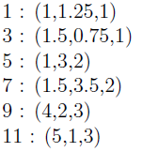
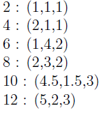
Samples of the dataset

Slide 57
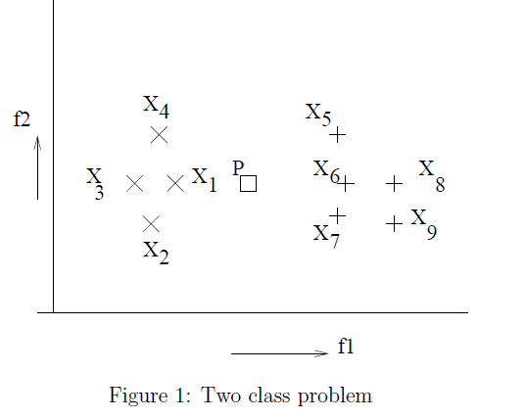
MKNN

Slide 58

Plot the following training data on XY-plane find NN of P=(3,2), when K=1, K-3

Slide 59


Plot the following training data on XY-plane find NN of P=(3,2), when K=1, K-3

Slide 60

Performance

Slide 61

Evaluation of Learning Algorithms

Slide 62

Predictions

Slide 63

Confusion Matrix

Slide 64


Slide 65

Classification rate/Accuracy

Slide 66

Recall

Slide 67

Precision

Slide 68

F-measure

Slide 69

Validation Set

Slide 70

K-fold cross validation

Slide 71

Trade off

Slide 72


Slide 73


Slide 74


Slide 75

Example

Slide 76



Minimal Distance Classifier

Slide 77

Concentric Classes

Slide 78


Data

